Slide 1
Introduction to Pedestrian and Bicycle Transportation:
Past, Present, and Future
Instructor course information
Notes:
Report No. FHWA-SA-19-034

Slide 2
Module Outline
History of walking and bicycling
Trends in mode share and safety
Emerging issues

Slide 3
History of Walking and Bicycling

Slide 4
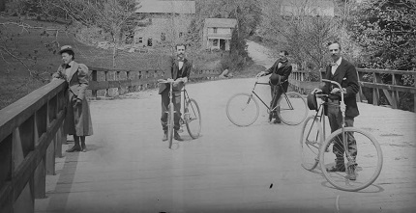
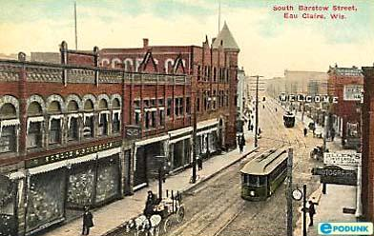
History of Walking and Bicycling
Pre-1900: Everyone is a pedestrian; bikes become popular in 1890s
Early 1900s: Good Roads Movement; cars become affordable
Evolution of street use
U.S. Library of Congress - Brady-Handy Collection
Wisconsin State Historical Society
Notes:
Key Message: Legislation and planning shaped U.S. community design and mode choice. Streets were previously for the public to merge social, recreational, and errand trips. Being on a street or watching the street was partaking in the “theatre of life.” Streets have evolved to be less people-focused and more movement-focused, which can have negative effects for people walking.
Notes: In the 1880s and 1890s, bicycles were the dominant vehicle on our nation’s roads. With the introduction of the “safety” bicycle, with two wheels of the same size, and the pneumatic tire in the late 1880s, the bicycling craze became an economic, political, and social force in the U.S. By 1890, the U.S. was manufacturing more than 1 million bicycles each year. In the early 1900s, the biggest contributor to crashes for bicyclists existed outside the cities; the poor condition of the nation’s roads made bicycling a laborious and dangerous process. Bicycle groups worked at the Federal, State, and local levels to secure road improvement legislation. The work of these advocacy groups became known as the Good Roads Movement.
Source: FHWA. Road Safety Fundamentals; Concepts, Strategies, and Practices that Reduce Fatalities and Injuries on the Road. (2017). U.S. Department of Transportation. Ed. Daniel Carter. Available: https://rspcb.safety.fhwa.dot.gov/rsf/
Top image via FHWA Road Safety Fundamentals (2017) shows three men with bicycles on a bridge in Washington DC circa 1885.
Bottom image via slides by Robert Schneider.

Slide 5
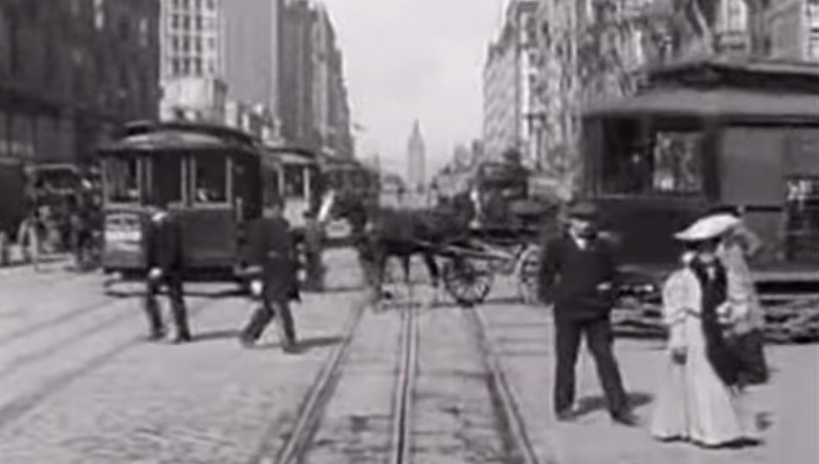
History of Walking and Bicycling
Walking and riding a bicycle early 1900s
San Francisco streetcar video clip (1905) http://www.youtube.com/watch?v=NINOxRxze9k
Evolution of design of streets
Still image from YouTube video posted by cleaverb
Notes:
Notes: With the introduction of the automobile, there were safety concerns about cars hitting people, so auto manufacturers lobbied to have separated space – get the people off the streets and keep the streets for the cars.
Engineering standards became the driver of street designs that focused on separating people from cars, so cars could go faster.
The needs and desires of the community became less important for the design of streets.
Current practice is focused on decreasing congestion and delay, with solutions that prioritize the car over other modes.
Source: http://www.youtube.com/watch?v=NINOxRxze9k [Accessed May 2019]

Slide 6
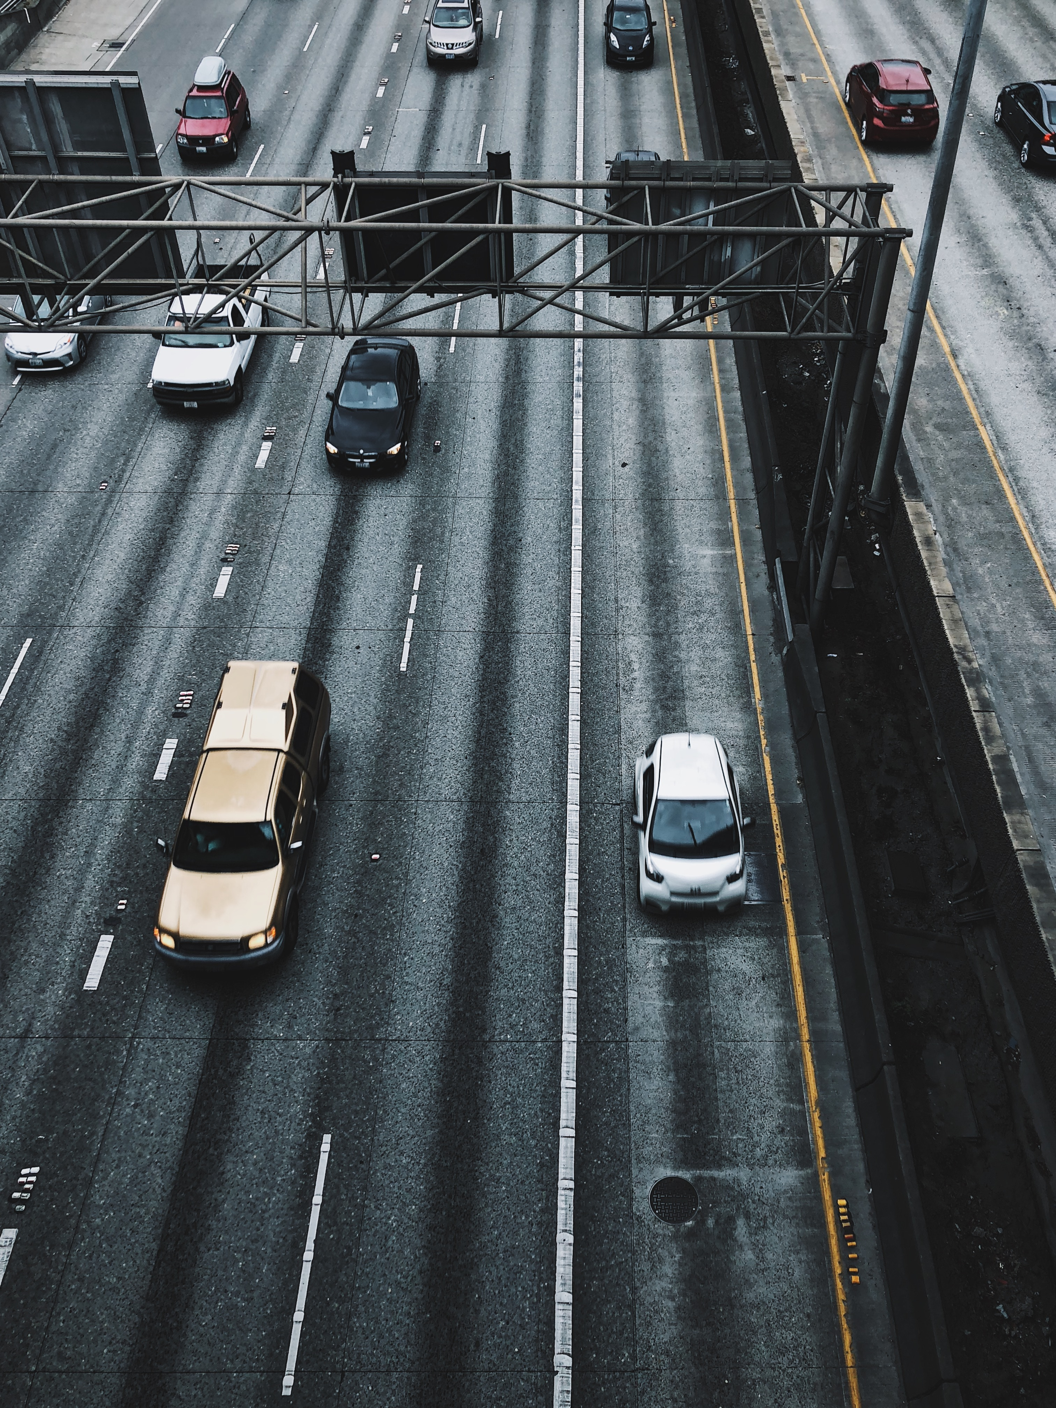
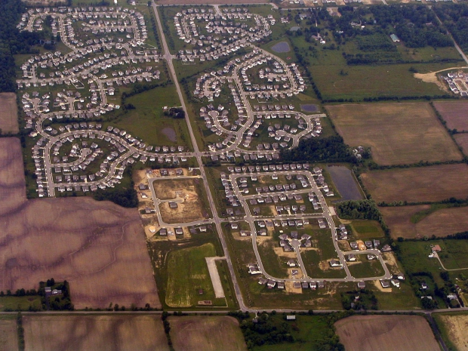
History of Walking and Bicycling
1956 National Interstate and Defense Highways Act
  Rapid expansion; destruction of neighborhoods
’50s–’90s: Dispersion of housing and jobs
Unsplash – Jeremy Bishop
pedbikeimages.org – Dan Burden
Notes:
Notes: Though the National System of Interstate Highways had been established by legislation in 1944, little progress was made over the next decade. It was the 1956 Act signed by President Eisenhower that linked the development of the interstate highway system to the interest of national defense and assigned funding that would rapidly expand the highway network. Despite the enthusiasm of political and business leaders, the growth of this system was not without its critics. These critics primarily denounced the destruction of homes and separation of communities that sometimes resulted from new highways bisecting established neighborhoods. Though this opposition halted projects in some locations, it did not stop the expansion of the interstate highway system. The Highway Trust Fund (amassed through fuel taxes) subsidized suburban and exurban road infrastructure. The current automobile-dominated landscape of the U.S. is often traced back to the 1956 Highways Act. The construction and expansion of the U.S. highway system has focused on providing increased mobility and has fostered the decentralization of development in this country.
During this time, “automobiles replaced streetcars, the need for locating houses close to the streetcar stop disappeared. Retail business concentrated near the residential subdivisions and apartment complexes, curbs and sidewalks, symbols of a pedestrian and streetcar-oriented world, became expensive and unnecessary features in this new, low-density environment. House lots became wider to accommodate garages and houses themselves were set back from the street to reduce the noise and nuisance of passing cars.” (Untermann, Richard K., Linking Land Use and Transportation: Design Strategies to Serve HOVs and Pedestrians, Washington State Transportation Commission, Olympia, WA, 1991.)
Sources: adapted from slides by Robert Schneider.
FHWA. Road Safety Fundamentals; Concepts, Strategies, and Practices that Reduce Fatalities and Injuries on the Road. UNIT 1: Foundations of Road Safety. (2017). U.S. Department of Transportation. Ed. Daniel Carter. Available: https://rspcb.safety.fhwa.dot.gov/rsf/

Slide 7
History of Walking and Bicycling
1970s: Oil crisis
1971: Oregon “Bicycle Bill”
  Early example of Complete Streets approach with State highway funds to back it up
1972: Davis, CA, builds connected network of bike lanes
1970s: Emergence of “vehicular cycling” advocacy in response to increased interest in bicycle lanes
  Influenced State and national design guidance for decades
  1980s: Rails to Trails movement
Notes:
Notes: The 70s and 80s saw a shift in automobile focus in response to the oil crisis and rising concerns about the environment. Instead of focusing solely on the automobile, policy makers, planners, advocates, and engineers slowly started to include active transportation as awareness grew surrounding the benefits of pedestrian and bicycle mobility. The Oregon “Bicycle Bill” required the Oregon Department of Transportation, counties, and cities to provide walkways and bikeways on all construction, reconstruction, or relocation projects.
Source: Schultheiss, W., Sanders, R. L., & Toole, J. (2018). A Historical Perspective on the AASHTO Guide for the Development of Bicycle Facilities and the Impact of the Vehicular Cycling Movement. Transportation Research Record, 2672(13), 38–49. https://doi.org/10.1177/0361198118798482

Slide 8
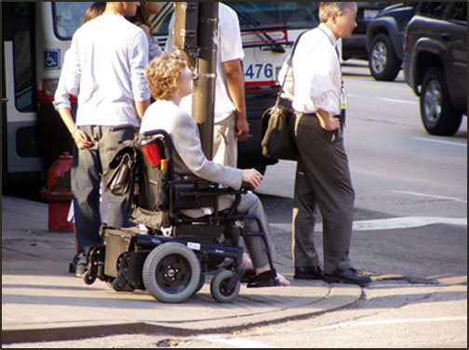
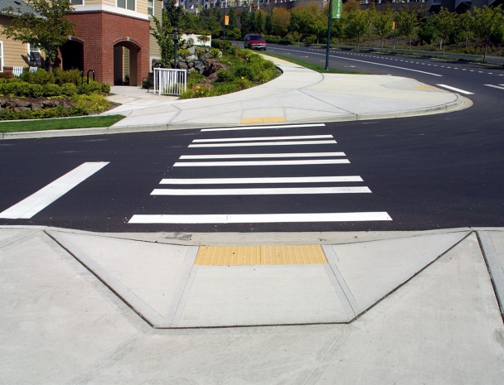
History of Walking and Bicycling
1990: Americans with Disabilities Act (ADA)
  Intended to ensure that pedestrians with disabilities have an equal opportunity to use public rights-of-way
pedbikeimages.org – Dan Burden
Notes:
Connection to other Module: Accessibility and ADA
Source: Federal Highway Administration, Office of Civil Rights. “Americans with Disabilities Act.” Available: https://www.fhwa.dot.gov/civilrights/programs/ada/ [Accessed May 2019].

Slide 9
History of Walking and Bicycling
1991: Intermodal Surface Transportation Efficiency Act (ISTEA)
  Supported research and encouraged bicycle and pedestrian plans
  Required each State DOT to designate a bicycle and pedestrian coordinator
  Mandated National Bicycling and Walking Study (published in 1994)
Notes:
Notes: Through the 1980s, the primary source of money for surface transportation projects was the gas tax and receipt of funds was tied to the measure Level of Service (LOS). At the Federal level, ISTEA was the first major investment and recognition of the importance and need for active transportation facilities. This coincided with the revival of downtown main streets and central city neighborhoods, as well as growth in local and regional level bicycle advocacy.

Slide 10
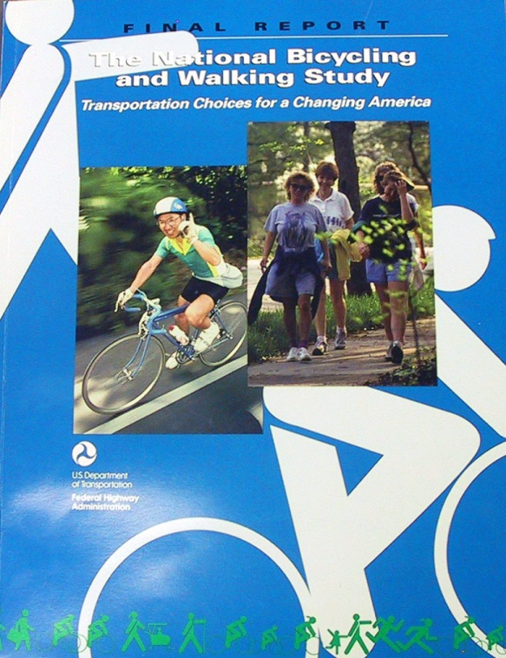
History of Walking and Bicycling
National Bicycling and Walking Study, two goals:
  Reduce by 10% the number of bicyclists and pedestrians killed or injured in traffic crashes
  Double the percentage of total trips made by bicycling and walking in the U.S. (from 7.9% to 15.8%)
Notes:
Key Message: The National Bicycling and Walking Study in 1994 set goals of increasing biking and walking trips while decreasing injuries. While the study signaled national recognition that walking and bicycling should be important modes of transportation in the future, the report serves mostly as a resource, and does not set a timeframe for reaching the goals.
Source: adapted from slides by Robert Schneider.
Image from Federal Highway Administration. (1994). National Bicycling and Walking Study. (FHWA-PD-94-023). Washington, DC: United States Department of Transportation.

Slide 11
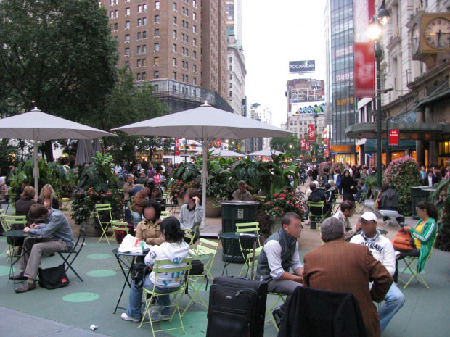
History of Walking and Bicycling
2000s: New Urbanism
2010: Livability as key principle in planning for walking and bicycling
2005: Federal-aid Safe Routes to School Program
pedbikeimages.org – Laura Sandt
Notes:
Notes: Changes and increased competition also occurred at the Federal and State levels for bicycle and pedestrian funding. Livability was identified as a key principle for pedestrian and bicyclist needs, meaning that a more vibrant, livable, healthy, and accessible community is one that does not focus solely on automobile access but also on how walk-friendly or bike-friendly a community is.

Slide 12
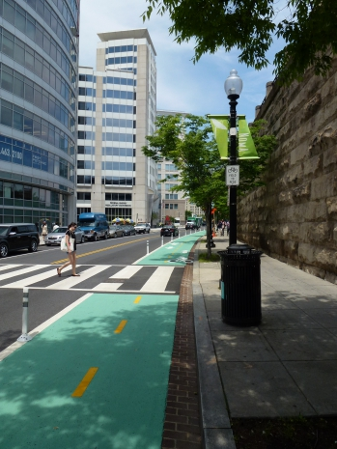
History of Walking and Bicycling
2010 – present:
  Increasing interest from, and coordination with, the public health profession
  Complete Streets
  Consolidated Federal funding
  Research on bicyclist preferences for separated facilities
  Vision Zero
pedbikeimages.org – Toole Design Group

Slide 13
Trends

Slide 14
Mode Share Trends
U.S. planning and legislation trends have influenced mode choice and mode convenience
  Planning and zoning regulations have favored low-density, automobile-oriented development
  Many planners and designers still do not consider pedestrians and bicyclists
  Oversupply of parking incentivizes individuals to drive
Notes:
Notes: Cities with subdivision ordinances and street design standards often require wide streets and sometimes do not require sidewalks. The concept of multimodal or context-sensitive design is often not supported by standard design practices or is reserved only for special projects. Huge supply of free parking exists; when a good is over-supplied, it becomes cheap and the demand increases.
Connection to other Module: more on this topic in the module, Factors Influencing Mode Choice.

Slide 15
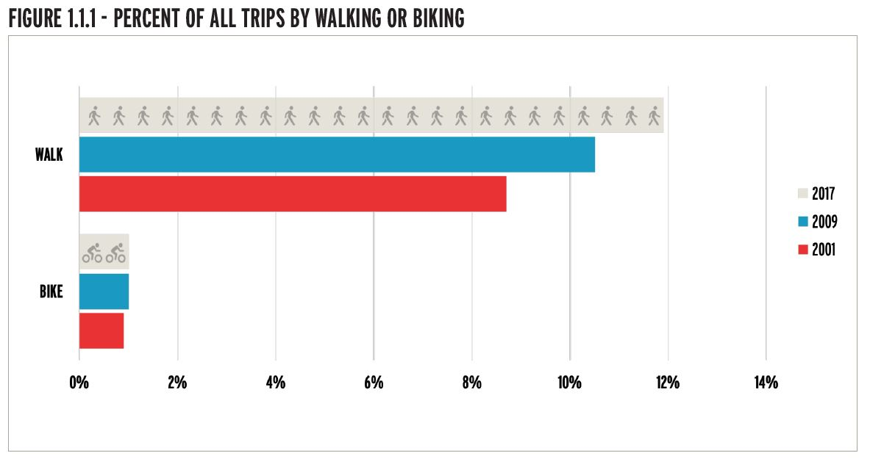
Walking & Biking Trips
Percent of All Trips
League of American Bicyclists (Data Source: FHWA National Household Travel Survey)
Notes:
Notes: Data from the National Household Travel Survey (NHTS) suggests that bicycling has been relatively stable as a percentage of all trips in the United States. Between 2009 and 2017, about 1% of all trips in the United States were taken by bicycle. Over the same time, there was a statistically significant increase in walking trips as a percentage of all trips, increasing from 10.5% of all trips to 11.9% of all trips. This early analysis of NHTS data was conducted by Dr. Ralph Buehler for the League of American Bicyclists.
Source: League of American Bicyclists (2019). Bicycling and Walking in the United States: 2018 Benchmark Report. Available https://bikeleague.org/benchmarking-report
(Slide image is Figure 1.1.1. in the Appendix of the Benchmark Report)

Slide 16
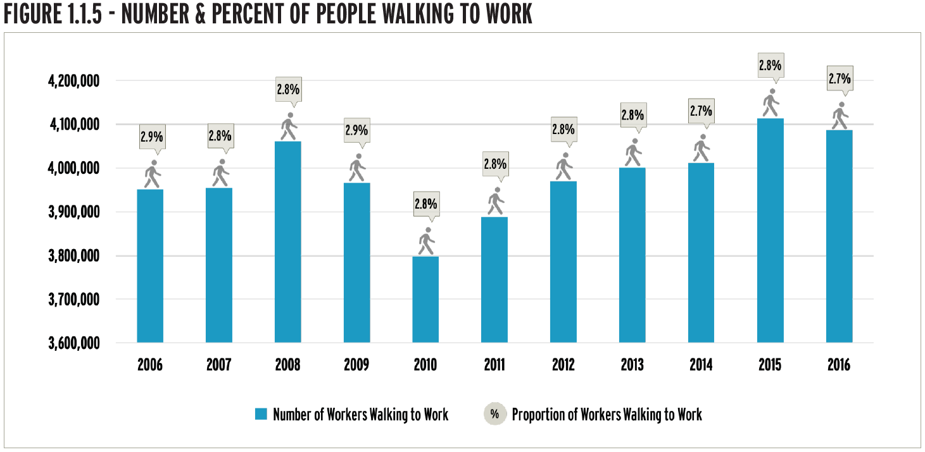
Walking to Work
Number and Percent of People Walking to Work
League of American Bicyclists (Data Source: American Community Survey 1-year estimates 2006-2016)
Notes:
Source: League of American Bicyclists (2019). Bicycling and Walking in the United States: 2018 Benchmark Report. Available https://bikeleague.org/benchmarking-report
(Slide image is Figure 1.1.5. in the Appendix of the Benchmark Report)

Slide 17
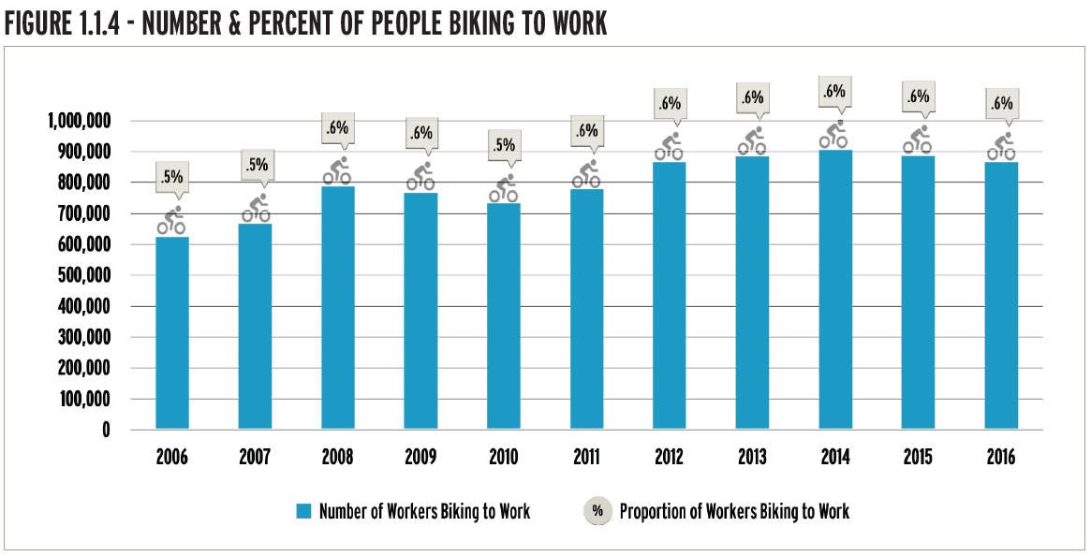
Bicycling to Work
Number and Percent of People Bicycling to Work
League of American Bicyclists (Data Source: American Community Survey 1-year estimates 2006-2016)
Notes:
Student Question: Do these mode share trends feel encouraging or discouraging?
Source: League of American Bicyclists (2019). Bicycling and Walking in the United States: 2018 Benchmark Report. Available: https://bikeleague.org/benchmarking-report
(Slide image is Figure 1.1.4. in the Appendix of the Benchmark Report)

Slide 18
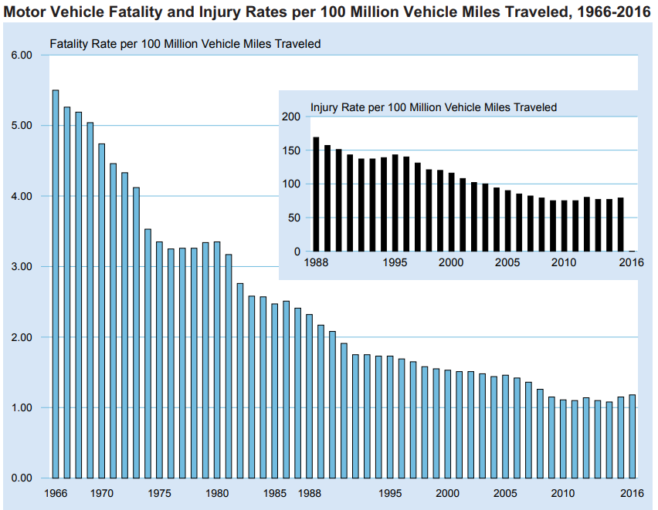
Safety Trends: Motor Vehicles
NHTSA
Notes:
Key Message: Fatality and injury rates per vehicle miles traveled (VMT) have been trending down for decades. However, the next few slides will show how fatalities for pedestrians and bicyclists are not trending in the same direction. In fact, the proportion of pedestrian deaths compared with all highway deaths rose over the past decade, from one in nine in 2007 to one in six in 2016 (NHTSA, 2018).
Notes: Keep in mind that we do not have a measure of exposure for pedestrians and bicyclists that is as precise as VMT, so you will see absolute numbers on the following slides.
Source: NHTSA Traffic Safety Facts 2016 (published 2018). Available: https://crashstats.nhtsa.dot.gov/Api/Public/ViewPublication/812554

Slide 19
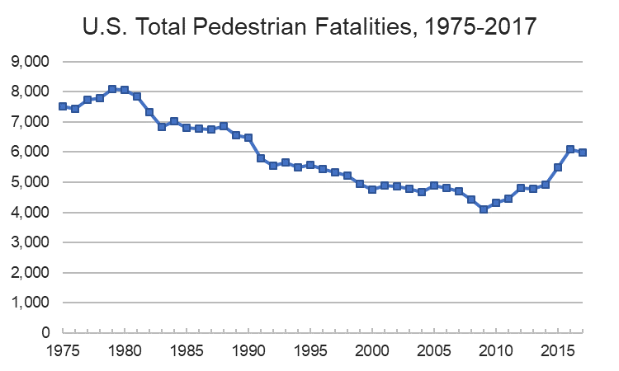
Safety Trends: Pedestrians
IIHS-HLDI Fatality Facts (Data Source: FARS)
Notes:
Notes: Pedestrian motor vehicle crash deaths have increased 45% since reaching their low point in 2009 and account for 16% of all crash fatalities.
Source: Insurance Institute for Highway Safety and Highway Loss Data Institute. (2018). Fatality Facts 2017: Pedestrians. Available: https://www.iihs.org/topics/fatality-statistics/detail/pedestrians [Accessed July 2019]
Note about FARS: “IIHS publishes annual statistical summaries of the motor vehicle safety picture. Fatality Facts are updated once a year, when the U.S. Department of Transportation releases data from the Fatality Analysis Reporting System (FARS). FARS is a census of fatal crashes within the 50 states, the District of Columbia and Puerto Rico, dating back to 1975. Any crash involving a motor vehicle traveling on a public road that results in a death within 30 days is included in FARS.” (Insurance Institute for Highway Safety and Highway Loss Data Institute, https://www.iihs.org/topics/fatality-statistics)

Slide 20
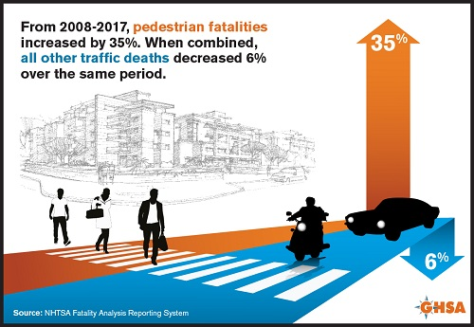
Safety Trends: Pedestrians
Notes:
Notes: This is a graphic representation of the data that were presented on the previous two slides.
Source: Governors Highway Safety Association. (2019). "Pedestrian Traffic Fatalities by State: 2018 Preliminary Data.“ Available: https://www.ghsa.org/resources/Pedestrians19

Slide 21
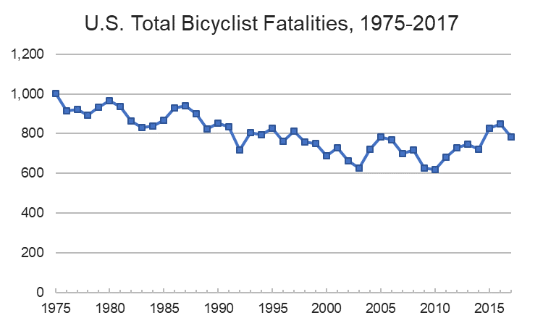
Safety Trends: Bicyclists
IIHS-HLDI Fatality Facts (Data Source: FARS)
Notes:
Notes: Although bicyclist deaths have decreased 23% since 1975, they have increased 25% since reaching their lowest point in 2010. Each year about 2% of motor vehicle crash deaths are bicyclists. Child bicyclist deaths have declined over the years, but deaths among bicyclists age 20 and older have tripled since 1975.
Source: Insurance Institute for Highway Safety and Highway Loss Data Institute. (2018). Fatality Facts 2017: Bicyclists. Available: https://www.iihs.org/topics/fatality-statistics/detail/bicyclists [Accessed July 2019]

Slide 22
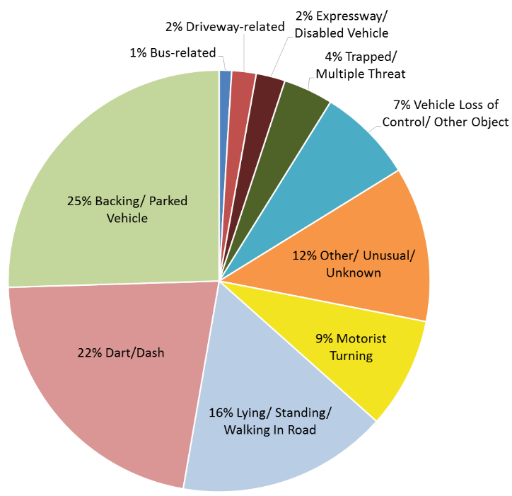
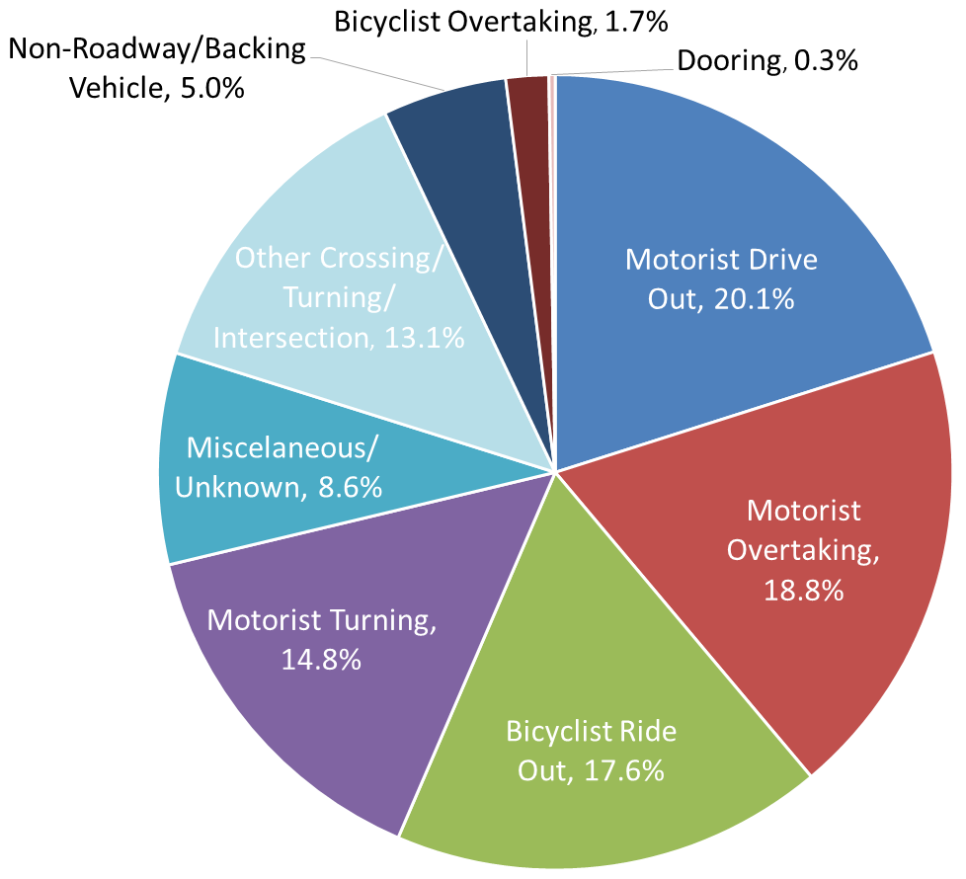
Present Day Crash Types
Pedestrian
Bicyclist
UNC Highway Safety Research Center (Data source: North Carolina Crash Data 2007-2014)
Notes:
Notes: This slide shows crash type data from the State of North Carolina. The percentage for each crash type will vary across the United States, but in general, the current factors that contribute to pedestrian and bicycle crashes can be attributed to a driver failing to see or react quickly enough to a pedestrian or bicyclist, sometimes due to driver distraction or impairment. Many other crashes occur when drivers fail to yield or pass a bicyclist safely. New technologies that can detect pedestrians and bicyclists better and provide more predictable reactions could be very important for improving the safety and comfort of pedestrians and bicyclists.
Source: Adapted from Clamann, M. and Sandt, L. PBIC Automated Vehicle Module Series. Pedestrian and Bicycle Information Center, Chapel Hill, NC: 2019.
Note: The latest crash type summary reports for North Carolina are available: http://www.pedbikeinfo.org/pbcat_nc/

Slide 23
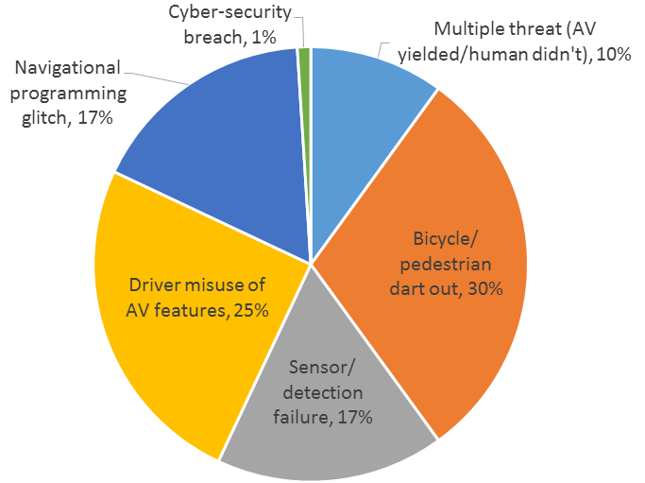
Crash Types of the Future?
Hypothetical Data
Notes:
Notes: As the revolution in automation continues, it is important to think about how walking and bicycling may be affected. For example, how will the nature of roadway crashes involving pedestrians and bicyclists change? Perhaps we might see fewer human driver errors, but more problems with failed systems or vehicle programming, or drivers may poorly understand when and how to use automated features. Or we may see people adapting to automated vehicles and changing the ways that they walk and bike and look for and communicate with traffic, and that might cause new problems as well.
Source: Adapted from Clamann, M. and Sandt, L. PBIC Automated Vehicle Module Series. Pedestrian and Bicycle Information Center, Chapel Hill, NC: 2019.

Slide 24
Emerging issues

Slide 25
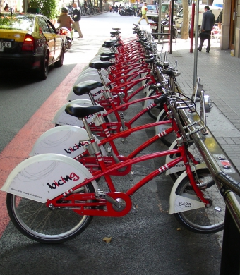
Emerging Issues
Transportation market disrupters
  Transportation Network Companies (TNCs), like Uber and Lyft
  Shared mobility
    Carshare, bike share, and other shared transportation resources
  Micromobility
    E-scooters and other small vehicles
  Automated vehicles (AVs)
    More slides on this later…
pedbikeimages.org – Ryan Snyder
Notes:
Notes: Recent transportation and technology trends are potentially shifting how people move around an area and how they make decisions about transportation. TNCs, shared mobility, micromobility, and automated vehicles could all make big impacts on mode share and the maintenance and future designs of our transportation infrastructure. It’s important to think about how these emerging trends could have negative impacts or benefits for some people. It’s important to consider the users of these new modes, and who has access to these technologies. Who is funding the expansion of and profiting from these new technologies? Individuals who are low-income or have disabilities might be excluded without careful planning and the appropriate policies, but in certain scenarios they might benefit.
Student Question: What issues or benefits might occur from the introduction of these emerging technologies?
Connection to other Module: Connections to Transit and Shared Mobility

Slide 26
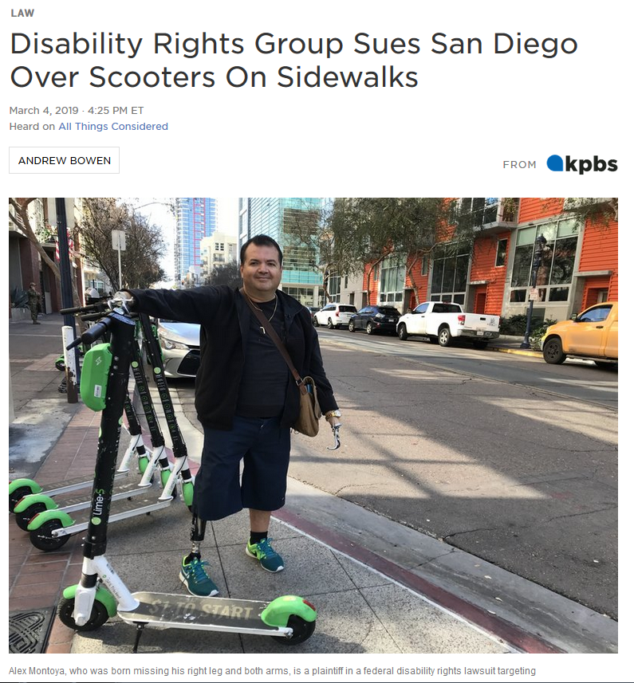
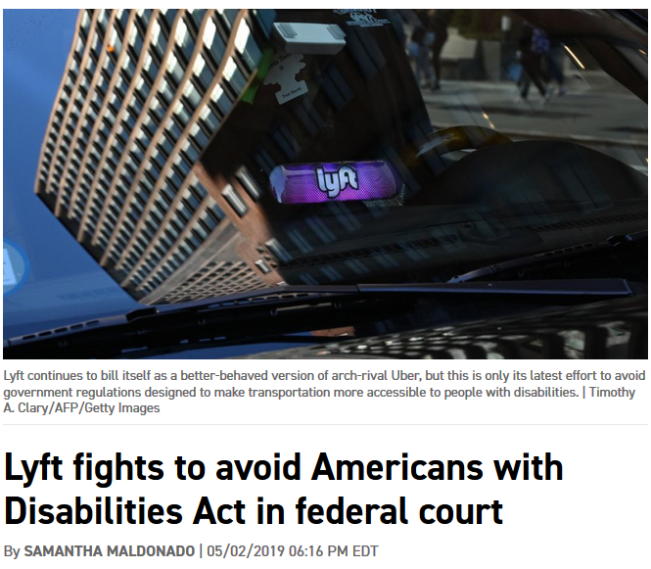
Market Failures: Equity and Accessibility
NPR.org
Politico
Notes:
Notes: As tech firms can operate in public space, they have some ownership of our travel systems, which have traditionally been operated by governments and private companies. Private firms will always be driven by market forces and subject to market failures, which we’re already seeing in the headlines. There are questions about how these technologies can support mobility, health, and physical activity goals in rural areas. Right now, e-scooters have very tight service areas that tend to be limited to the urban core and college campuses, and some places have already banned them from usage on trails.
Source:
Disability Rights Group Sues San Diego Over Scooters on Sidewalks (March 4, 2019) by Andrew Bowen for KPBS. Available: https://www.npr.org/2019/03/04/698768297/disability-rights-group-sues-san-diego-over-scooters-on-sidewalks
Lyft fights to avoid Americans with Disabilities Act in federal court (May 2, 2019) by Samantha Maldonado for Politico. Available: https://www.politico.com/states/new-york/albany/story/2019/05/02/lyft-fights-to-avoid-americans-with-disabilities-act-in-federal-court-1002249

Slide 27
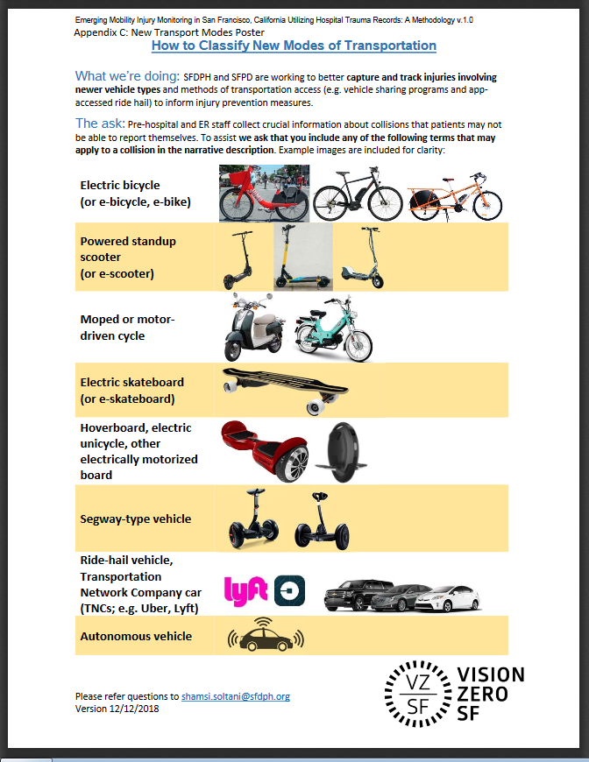
Implications for Data Collection
San Francisco's proactive approach to crash data collection
  Updated police crash report and trauma registry questions to support “tagging” of incidents involving emerging modes
SFDPH
Notes:
Notes: The recent proliferation of new mobility technologies presents a challenge to the local and state governments who regulate them, and the hospitals and trauma centers charged with treating injuries associated with these emerging vehicle types. This methodology in San Francisco is a response to the need for timely and high-quality data to empirically track and better understand injuries arising from use of these formerly uncommon vehicles. It provides an opportunity to study emerging innovations and to inform data-driven injury prevention efforts (Vision Zero SF, 2019).
Connection to other Module: This slide is also shown in the Connections to Transit and Shared Mobility module.
Source: Adapted from Clamann, M. and Sandt, L. PBIC Automated Vehicle Module Series. Pedestrian and Bicycle Information Center, Chapel Hill, NC: 2019.
Vision Zero SF Injury Prevention Research Collaborative (2019) A Methodology for Emerging Mobility Injury Monitoring in San Francisco, California Utilizing Hospital Trauma Records: Version 1.0. San Francisco, CA. Available: https://www.sfdph.org/dph/EH/PHES/PHES/TransportationandHealth.asp
Image: https://www.sfdph.org/dph/files/EHSdocs/PHES/VisionZero/Emerging_Mobility_Injury_Monitoring_Methodology.pdf

Slide 28
AV – Levels of Automation
Pedestrian and Bicycle Information Center (2017)
Notes:
Notes: The Society of Automotive Engineers (SAE) developed a taxonomy including six automation levels to describe how responsibilities are divided between a driver and a system for different types of automated vehicles. The levels range from no driving automation (level 0) to full driving automation (level 5). The levels of driving automation are associated with roles played by the driver and the system when in performing the dynamic driving task (DDT) and/or DDT fallback. The SAE Levels of Automation are broadly used when describing automated vehicle functions and capabilities.
Source: Sandt, L. & Owens, J.M. (August 2017). Discussion Guide for Automated and Connected Vehicles, Pedestrians, and Bicyclists. Pedestrian and Bicycle Information Center. Chapel Hill, NC. Available: http://www.pedbikeinfo.org/resources/resources_details.cfm?id=5082

Slide 29
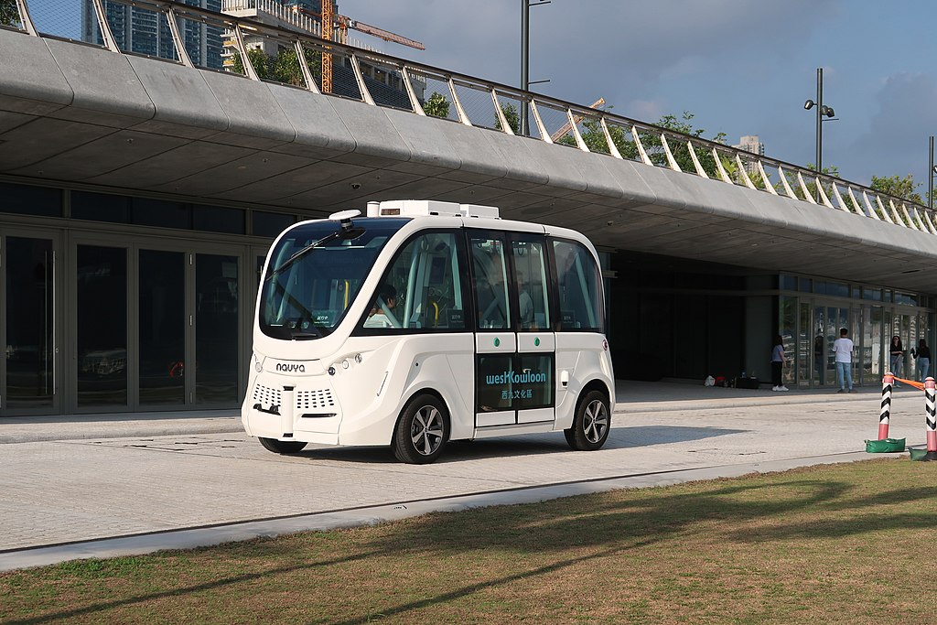
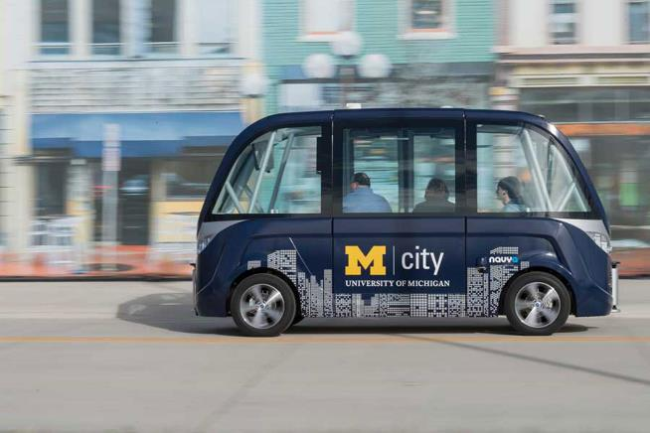
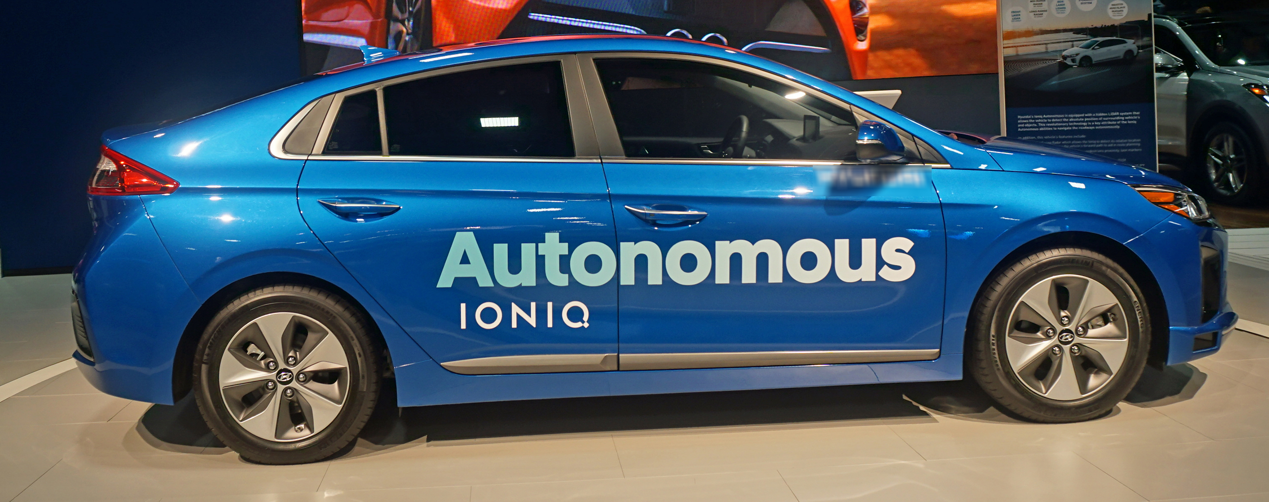
AV – Current Applications
Limited deployment and/or research efforts:
  Ridesharing
  Urban shuttles
  Trucking
Wikimedia – user Wpcpey
University of Michigan
Wikimedia – user Mariordo
“The U.S. Government does not endorse products or manufacturers. Trademarks or manufacturers’ names appear in this presentation only because they are considered essential to the objective of the presentation. They are included for informational purposes only and are not intended to reflect a preference, approval, or endorsement of any one product or entity.”
Notes:
Notes: Autonomous vehicles could change multiple transportation concepts. Below are just three possible applications:
The Waymo One ridesharing program lets participants use an app to call an autonomous vehicle to bring them to a destination within a limited service area.
Trucking companies could reduce costs by decreasing the number of drivers and taking advantage of improved efficiency from platooning. In this case, a lead truck sends wireless commands to the following trucks to regulate speed, steering, braking and distance between the trucks.
Short shuttle routes are a convenient entry point for automated vehicles because their low speeds present fewer safety challenges and the fixed routes are easy to navigate.
Source: Adapted from Clamann, M. and Sandt, L. PBIC Automated Vehicle Module Series. Pedestrian and Bicycle Information Center, Chapel Hill, NC: 2019.Images:

Slide 30
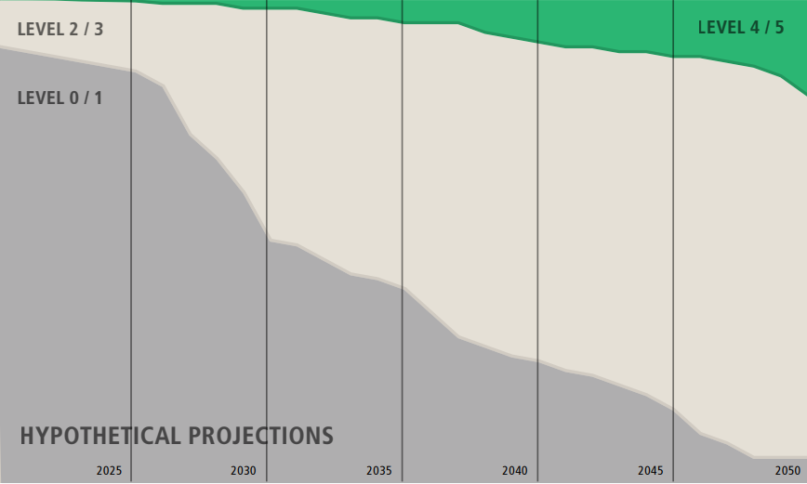
AV – The Future
The billion-dollar questions:
  When will “fully autonomous” vehicles become available to the general public?
  How long will we have a mixed fleet where AVs and human-driven vehicles coexist?
Pedestrian and Bicycle Information Center (2017)
Notes:
Notes: Hypothetical projections of the total U.S. vehicle fleet composition with respect to level of automation, indicating that lower levels of automated vehicles will represent a large portion of the vehicle fleet for a long period of time. Data are hypothetical as there is currently no industry consensus or reliable estimate for specific levels of automation over time.
Source: Adapted from Clamann, M. and Sandt, L. PBIC Automated Vehicle Module Series. Pedestrian and Bicycle Information Center, Chapel Hill, NC: 2019.
Image from: Sandt, L. & Owens, J.M. (August 2017). Discussion Guide for Automated and Connected Vehicles, Pedestrians, and Bicyclists. Pedestrian and Bicycle Information Center. Chapel Hill, NC. Available: http://www.pedbikeinfo.org/resources/resources_details.cfm?id=5082

Slide 31
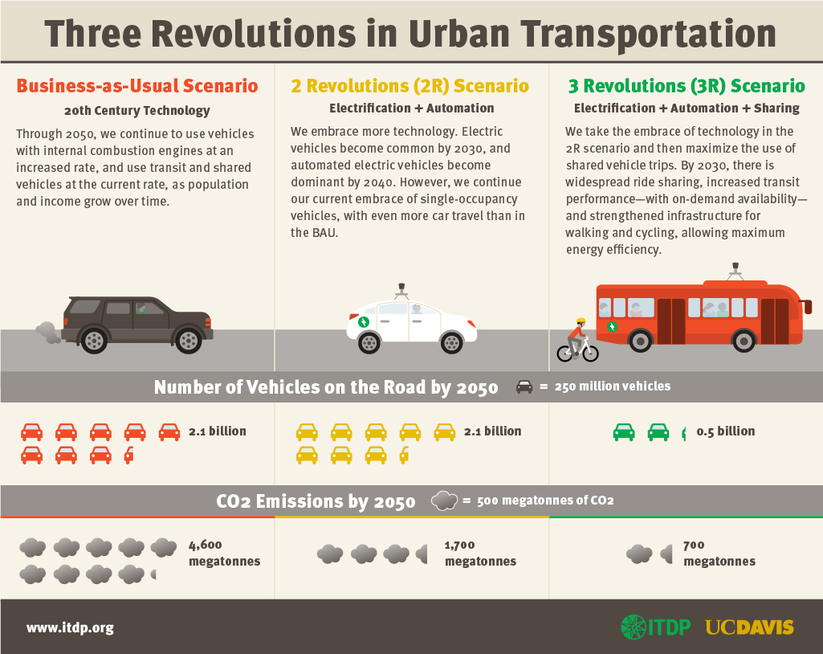
AV – Context with Other Innovations
Notes:
Student Question: What is “driving” the pace of AV development?
(responses may include: speculation over profits, desire for safety or environmental reform, advancements in data storage and computing).
Who is “driving the change? Who has a seat at the table? Who doesn’t?
Source: Adapted from Clamann, M. and Sandt, L. PBIC Automated Vehicle Module Series. Pedestrian and Bicycle Information Center, Chapel Hill, NC: 2019.

Slide 32
AV – Challenges for Communication and Interaction Between Drivers/Pedestrians
When pedestrians cross a street:
  Drivers and pedestrians assume common norms about right-of-way (varies according to local culture)
  They want to know whether they have been seen
  Pedestrians are often harder for drivers to see than other objects in the road
To prevent collisions, drivers and pedestrians need to:
  Detect each other
  Communicate
Notes:
Key Message: Automated vehicles and people walking will need to interact in new ways.
Notes: From a young age we are taught to make eye contact with the driver. When there is no driver, pedestrians will need to replace these old habits with new ones (or learn how to understand mixed fleets). This will take time.
Source: Adapted from Clamann, M. and Sandt, L. PBIC Automated Vehicle Module Series. Pedestrian and Bicycle Information Center, Chapel Hill, NC: 2019.

Slide 33
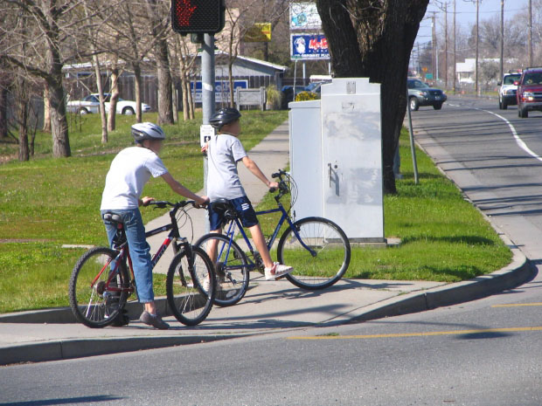
AV – Additional Challenges for Bicyclists
Bicyclists are expected to ride on road with other vehicles
Have the same low visibility problems as pedestrians
Vary in ability
Flexible in behavior
Pedbikeimages.org – Dan Burden
Notes:
Student Question: Is this the size and location of bicyclists that an AV will detect and react to?
Source: Adapted from Clamann, M. and Sandt, L. PBIC Automated Vehicle Module Series. Pedestrian and Bicycle Information Center, Chapel Hill, NC: 2019.

Slide 34
AV - Benefits to Pedestrians and Bicyclists
Consistent vehicle speeds
  Automated vehicles can be programmed to reliably follow lower speed limits, which reduce the severity of crashes
Data collection
  Detailed data recorded automatically by GPS and vision systems will facilitate rapid system improvements
  In the event of a crash, detailed data will be available for reporting and reconstruction
  Although, there are also privacy concerns for people detected and recorded by vision systems
Notes:
Source: Adapted from Clamann, M. and Sandt, L. PBIC Automated Vehicle Module Series. Pedestrian and Bicycle Information Center, Chapel Hill, NC: 2019.

Slide 35
AVs Could Change the System for the Better… Or Worse
Increased mobility for those unwilling or unable to drive
Reduced cost of congestion
Commuters more willing to travel longer distances to work
Decrease need for proximate parking as AVs drive themselves to satellite parking
Notes:
Notes:
Increased mobility for those unwilling or unable to drive:
Improved independence, reduction in social isolation, and access to essential services.
Reduced cost of congestion:
Vehicle occupants free to do other activities.
Could lead to an increase in overall vehicle miles traveled?
Which, in turn, could return the increases in negative externalities of driving, like congestion.
Does this erode the comparative advantage of public transit?
Commuters more willing to travel longer distances to work:
People relocate further from the urban core.
Decrease need for proximate parking as AVs drive themselves to satellite parking:
Resulting in increased urban density?
And undermining urban parking revenues.
Source: adapted from Clamann, M. and Sandt, L. PBIC Automated Vehicle Module Series. Pedestrian and Bicycle Information Center, Chapel Hill, NC: 2019.
Reference: Anderson, J., Kalra, N., Stanley, K., Sorenson, P., Samaras, C. and Oluwatola, O. (2014). Autonomous Vehicle Technology: A Guide for Policymakers. Rand Corporation. https://www.rand.org/pubs/research_reports/RR443-2.html

Slide 36
Summary
Post-WWII development patterns have hampered the ability to accommodate bicycle and pedestrian travel
Government and community support is leading to positive trends in planning and street design
As fatalities for vehicle passengers continue to decline, the trend is again moving in the wrong direction for people walking and bicycling
The transportation landscape is rapidly changing
Technology is a tool, not a solution, goal, or value
Notes:
Notes: Future safety issues will certainly arise as technological advancements lead to changes in the vehicle fleet. Autonomous and potentially driverless vehicles are being developed and tested across the world. Though safety improvements are touted as a benefit of these advanced vehicles, safety will continue to be a priority as they begin to share the roads with older vehicles, bicyclists, and pedestrians. As can be learned from the history of road safety in the U.S., complex problems must be met with safety advancements, legislative action, and collaboration.
Source: Speaker notes from FHWA. Road Safety Fundamentals; Concepts, Strategies, and Practices that Reduce Fatalities and Injuries on the Road. (2017). U.S. Department of Transportation. Ed. Daniel Carter. Available: https://rspcb.safety.fhwa.dot.gov/rsf/

